Slide 1
File System

Slide 2
Traditional File Environment
The organization has multiple applications with related data files
Each application has a specific data file related to it, containing all the data records needed by the application
Each application comes with an associated application-specific data file

Slide 3
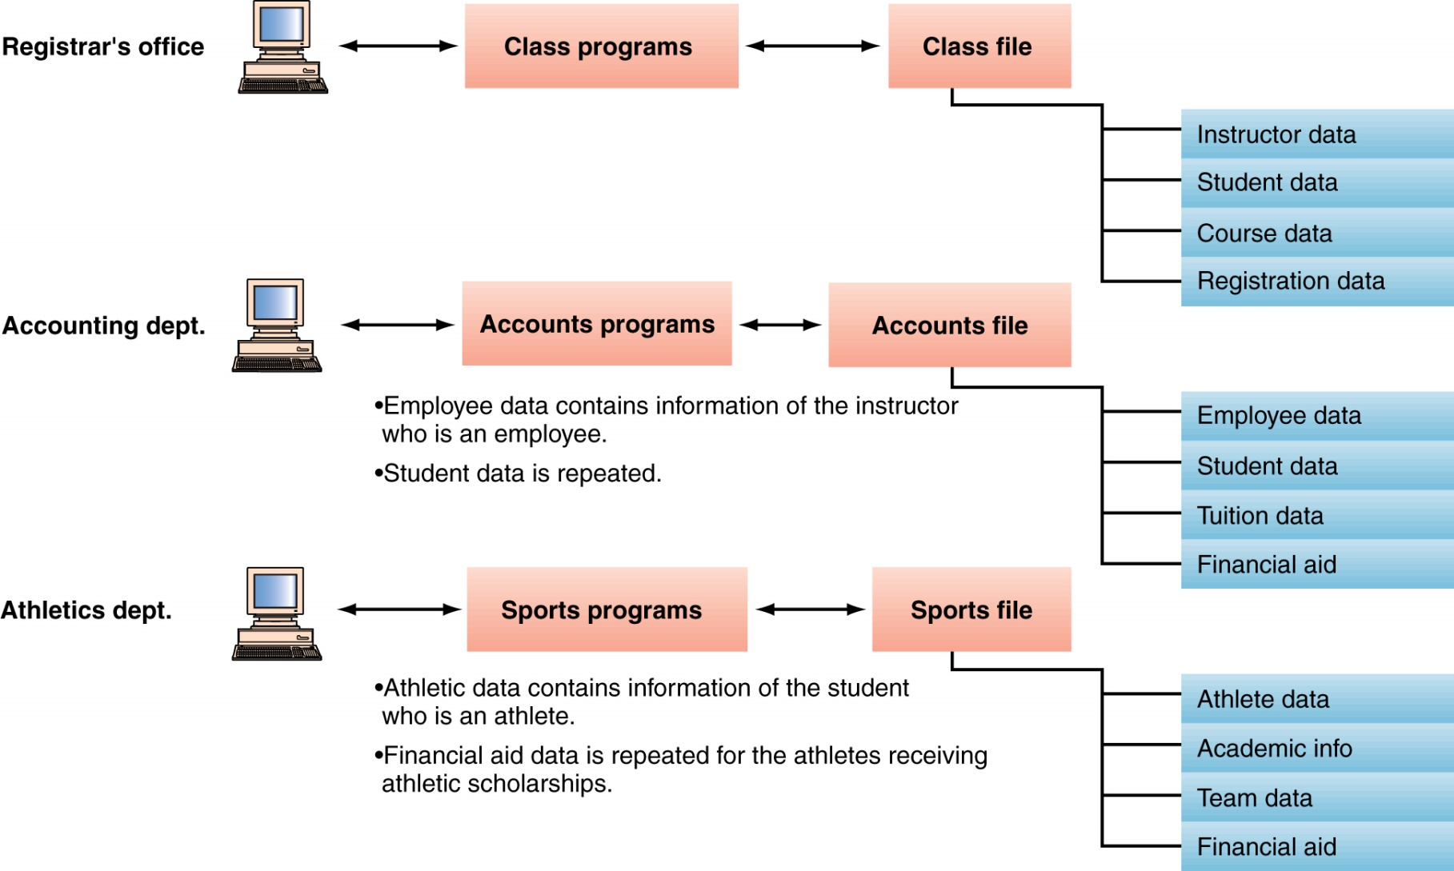
Traditional File Environment (continued)

Slide 4
Disadvantages
The conventional file processing system suffers from the following shortcomings.
Data Redundancy
Data Inconsistency
Difficulty in Accessing Data
Data Isolation
Integrity Problems
Atomicity Problem
Concurrent Access anomalies
Security Problems

Slide 5
Data Redundancy Data Redundancy means same information is duplicated in several files. This makes data redundancy. Data Inconsistency Data Inconsistency means different copies of the same data are not matching. That means different versions of same basic data are existing. This occurs as the result of update operations that are not updating the same data stored at different places.
Example: Address Information of a customer is recorded differently in different files.

Slide 6
Difficulty in Accessing Data It is not easy to retrieve information using a conventional file processing system. Convenient and efficient information retrieval is almost impossible using conventional file processing system. Data Isolation Data are scattered in various files, and the files may be in different format, writing new application program to retrieve data is difficult.
Integrity Problems The data values may need to satisfy some integrity constraints. For example the balance field Value must be greater than 5000. We have to handle this through program code in file processing systems. But in database we can declare the integrity constraints along with definition itself.

Slide 7
Atomicity Problem It is difficult to ensure atomicity in file processing system. For example transferring $100 from Account A to account B. If a failure occurs during execution there could be situation like $100 is deducted from Account A and not credited in Account B. Concurrent Access anomalies If multiple users are updating the same data simultaneously it will result in inconsistent data state. In file processing system it is very difficult to handle this using program code. This results in concurrent access anomalies. Security Problems Enforcing Security Constraints in file processing system is very difficult as the application programs are added to the system in an ad-hoc manner.

Slide 8
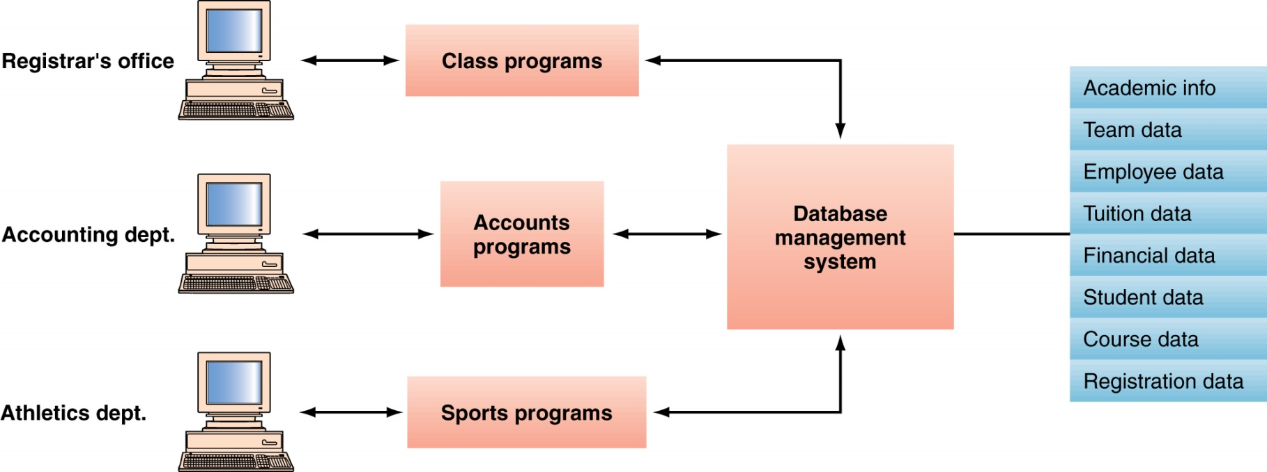
Database Management System (DBMS)
Database : The Modern Approach
The database management system provides access to the data

